Slide 1
Continuum of Care &
Community Response
Homeless 101: Day 1, Session 2
Courtney Knoll & Mike Manhard

Slide 2
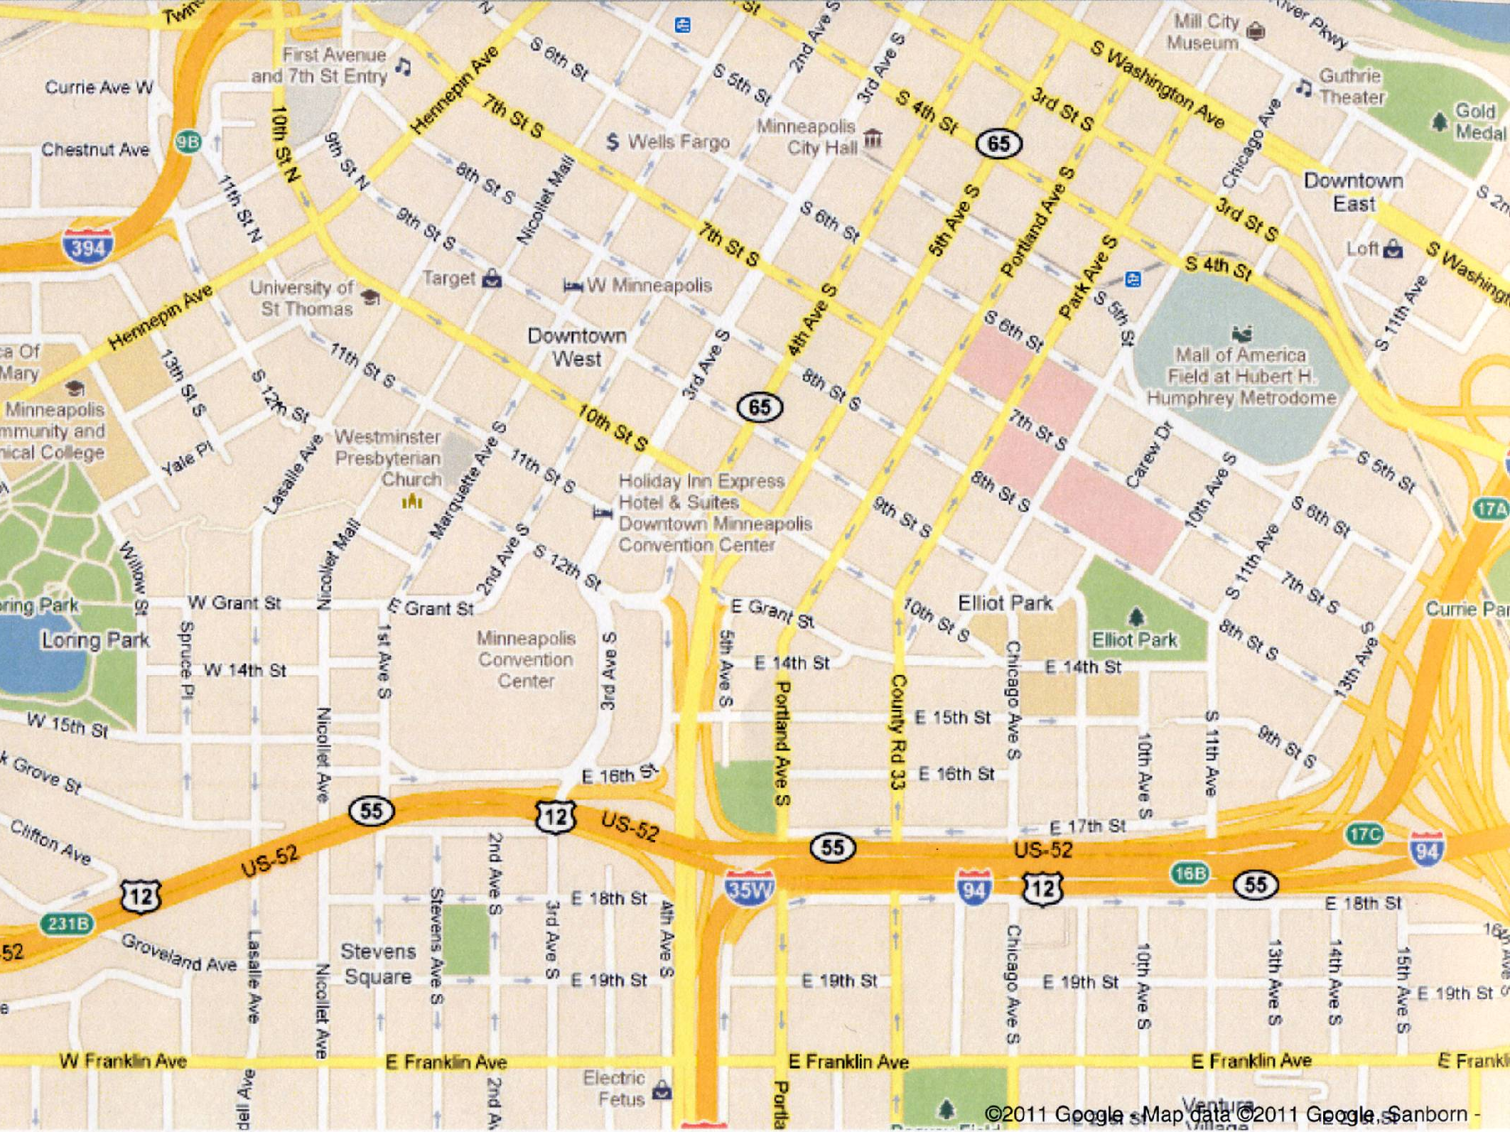
Community Engagement to End Homelessness
Questions?
Notes:
A little illustration to introduce why we are talking about the continuum of care and what we want to accomplish.
We are currently at Central Lutheran.
Nearby are four drop-in centers
Three limit their services to single adults
One program serves only youth
Two are faith-based
Two require an intake process and have a front desk service one has to go through for access
In addition, there are also over 5 locations nearby that provide shelter to people who are homeless.
Two serve homeless families
three serve only single adults
Two are faith-based organizations
In three locations, folks can stay during the day, while the other two only provide shelter at night
Two have strict rules about behavior and drug/alcohol use
Two have lenient rules about drug/alcohol use
One is a wet facility and does not restrict use at all depending on drug/alcohol use
Three shelters do not have limits on the amount of time a person can stay, while the others are limited to 30-60 days
We also have many programs nearby that house folks who have experienced homeless (7 listed)
5 are for single adults
2 are for families
2 are time limited, meaning folks cannot stay beyond 24 months
4 provide support services to help folks maintain their housing, the others do not
Some agencies are targeted only to people who are disabled or chemically dependent
Some require 30 days of sobriety before entering the program
Some are available only for folks who meet the “long-term homeless” criteria
Some require residents to be enrolled in school or have a job
So, can see lot of programs, a lot of people working to end homelessness
Leads to valid questions:
Why so many different programs?
Why different models?
Why the different rules?

Slide 3
Continuum of Care
Diversity of Housing & Services used to meet the specific needs of people who are homeless as they move to stable housing and maximum self-sufficiency
Notes:
Fact is, our approach to ending homelessness is complex Because we as people are complex.
We need the diversity. We need a wide ragne of responses, services, models to meet the diverse needs of the people who experience homelessness.
Certain rules or flexibility work for one, not another.
While this diversity is complex and sometimes confusing, it is a system—we call CoC
You’ll hear this term, in other fields, by HUD, etc. For our purposes it means:
Diversity of Housing & Services used to meet the specific needs of people who are homeless as they move to stable housing and maximum self-sufficiency
Repeat

Slide 4
Purpose
Identify the role your work plays in the continuum
Understand the continuum of care and Identify the need to partner together to end homelessness
Notes:
Purpose of the rest of this session is to understand a bit more about the Continuum of Care, what it looks like, BUT MORE IMPROTANTLY
How the work you provide fits into the bigger picture AND
To understand and embrace our need to work together as partners
Big point we want to make in this session. WE ARE ALL ON THE SAME TEAM. Represent different models, different parts of the continuum, but all needed to work towards a community w/o homelessness.

Slide 5
Brief Exercise
Use sheet to describe your work/interest
Find a partner and share information
Notes:
Who learned something new about your own organization?
Who has remaining questions? Why we/other organization does things the way they do?
Anyone able to identify how your work can connect to the work of your discussion partner?

Slide 6
continuum of care
Outreach
Homelessness
Prevention
Rapid
Re-Housing
Supportive
Housing
Affordable
Housing
Notes:
No hard and fast description of CoC
Has evolved and changed as our coordination and models have improved
5 elements to the CoC (going to hit on them very briefly right now, more detail of each element in a moment)
Outreach, intake, assessment-----Where do folks get connected to resources? In a functional CoC, this is where shelter belongs. Shelter should not be a landing place,
Homeless Prevention. Keeping people from becoming homeless
Rapid Re-Housing. Rapid Exit in Hennepin. Taken HUD a while, but now seeing RRH as vital part of CoC
Supportive Housing (both permanent & transitional)
Affordable Housing

Slide 7
Outreach
Who does this target?
People who are homeless or
at-risk of homelessness
People not already linked to services
Youth in sex work
People living without shelter
Looks much different in urban area than in suburban regions
Notes:
A little more about each of the elements of the CoC.
For each we are trying to answer, who does it target and what does it look like

Slide 8
Outreach
What does it look like?
Street Outreach
Partnerships with Police
Resources Awareness/Education
Project Homeless Connect/Stand Down
Emergency Shelter
Drop-ins/Opportunity Centers/Homeless Resource Center
Coordinated Access/No Wrong Door
Culturally Competent /Specific Services
School Liaisons
Notes:
By outreach, referring to more than just Street outreach
How do people who become or are at-risk of homelessness connect to resources they need? Where are the points of connection? How do folks enter into the continuum?
These entry points OUTREACH
Street outreach
Community centers/ parks/ malls/ streets/ etc
What do they provide?
Tokens, water, socks, food, condoms, basic healthcare, referrals, immediate needs
Partnerships with Police
Social service response vs. criminal justice response
Shelter –
Has historically served as a longer-term solution families.
In the ideal model/continuum, shelter is a temporary landing place for folks in housing crisis
Temporary solution, often on a nightly or short term basis
Although meant to be less than a month, length of stay has been increasing
Offer some services
Hearth Act/HUD will be judging communities on ability to avg. less than 28 days in shelter
MOST HOUSEHOLDS STABLIZE ON THEIR OWN

Slide 9
Homelessness Prevention:
Who is it For?
Low-Income
Limited to moderate barriers
At-risk of losing housing
Crisis likely to be resolved within reasonable timeline
Sometimes needing case management support, sometimes just needing cash assistance
Folks exiting public institutions (corrections, foster care, etc.)
Notes:
Low-Income
Limited to moderate barriers
Not hard fast rule, but in general
At-risk of losing housing
Make sure we are targeting resources to those most likely to need/benefit
Crisis likely to be resolved within reasonable timeline
Most 3-12 mo
Sometimes needing case management support, sometimes just needing cash assistance
Life skills, financial management
Folks exiting public institutions (corrections, foster care, etc.)

Slide 10
Homelessness Prevention:
What does it look like?
Direct Assistance
Limited Case Management/Services
Eviction Mitigation
Foreclosure Counseling/Mitigation
Conflict Resolution (Youth/Family)
Discharge Planning/Coordination
Notes:
Direct assistance for transportation, utilities, rent
Keep people in their housing
Conflict Resolution (between youth & family),
Eviction mitigation,
Foreclosure Counseling/Mitigation,
Ensure folks are not Discharged into homelessness (MH, CH, Corrections, Foster Care, Hospitals, etc.)
Develop/Improve protocol/policies to ensure housing after discharge from public institutions
Coordinate to identify housing funds & support services to assist those exiting institutions
Support for families with returning ex-offenders

Slide 11
Rapid Re-Housing
Who is it For?
People Who are Recently Homeless
Doubled-up
Likely to Become Stabilized with Short-term Assistance
Employed or Some Source of Income
Youth/Family Unification
Notes:
People Who are Recently Homeless
Doubled-up
Likely to Become Stabilized with Short-term Assistance
Employed or Some Source of Income
Related to earlier item
Youth/Family Unification

Slide 12
Rapid Re-Housing
What does it look like?
Direct Assistance
Outreach/Advocate to Landlords
Risk Pools
Family Unification Program
Screening/Referral
Refugee Families
Notes:
Direct assistance for transportation, utilities, rent
HUD expects less than 28 days in shelter
Rapidly Re-House Households who have become homeless
Utilize HUD funds to develop pilot program
Expand screening & referral

Slide 13
Supportive Housing
Who is it for?
People needing short-term or
long-term supportive services to gain and maintain stable housing
Long-term Homeless
Multiple Barriers

Slide 14
Supportive Housing
What does it look like?
Transitional Housing (time limited)
Permanent Supportive Housing
Site-based, Scattered, Mobile Teams
Variety of services and levels of intensity
Notes:
1) Transitional Housing
- Has a time limit: anywhere from 60 days – 2 years
- Transition to greater independence and self-sufficiency – often from homelessness
- Offer support services and stay can be contingent upon participating in services: Pay a modest fee or part of income as rent
2) Permanent Supportive Housing
- No limit on length of tenancy
- On a lease with the agency/landlord
- Support services offered but not required: access to support services
- Tenant pays no more than 30-50% of income towards rent
Support Services: site based, scattered site, mobile teams, etc.
Housing models:
Transitional Housing
Permanent Supportive Housing
Harm Reduction Housing Programs
Sober Housing Programs
Scattered site: independent living &/or supported
Project based
Services:
Safe Waiting
Job training
Case management
Substance abuse treatment/support
Mental health care
Housing placement
Life skills training
Child care
Budget management
Parenting classes
GED/education classes and tutoring

Slide 15
Affordable Housing
Who is it for?
Low-Income
Limited Barriers
Connections to Mainstream Resources (SSI)
Waiting Lists

Slide 16
Affordable Housing
What does it look like?
Section 8
Fair Market Rental
Public Housing
Support Services not provided/linked to housing
Develop/Rehab
Vouchers
Preservation
Notes:
3) Independent Living & Permanent Housing
- Fair market rental
- Home buying
- Support Services not provided
- Who is most likely to live in this?
- What are the barriers to these?

Slide 17
continuum of care
ADULT
Homelessness
Prevention
Homelessness
Prevention
Outreach
Homelessness
Prevention
Outreach
Outreach
Rapid
Re-Housing
Rapid
Re-Housing
Rapid
Re-Housing
Supportive
Housing
Supportive
Housing
Supportive
Housing
Affordable
Housing
Affordable
Housing
Affordable
Housing
FAMILY
YOUTH
Notes:
Should be noted that continuum looks different by population,
Different models, different services for unaccompanied youth than for single adults.
What might work well for one population not necessarily the best for another

Slide 18
continuum of care
Site-Based
Secular
Harm Reduction
Permanent
Supportive Services
Target Pop.
Sober
Outreach
Homelessness
Prevention
Rapid
Re-Housing
Supportive
Housing
Affordable
Housing
Wet
Scattered
Faith-based
Program Requirements
Transitional
Independent Living
Open
Notes:
Other Continuums:
Sober --- Wet
Site-based—Scattered
Secular --- Faith Based
Housing First/harm reduction ---- Strenuous Access Requirements
Permanent----Transitional
Supportive Services ----- Independent Living
Target Population ---- Open Admission

Slide 19
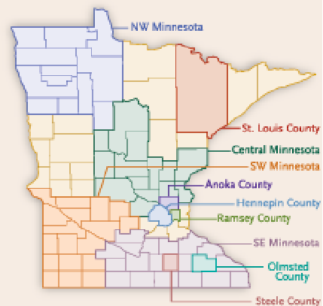
‘Heading Home’ Plans
Heading Home Minnesota
By 2011, all areas of MN will be covered by a county or regional plan to end homelessness
State has expanded plan to end ALL homelessness
Federal Plan created in 2010
Notes:
CoC—comprehensive elements to end homelessness
Gaps—coordination, adequate funding, common goals
That’s where plans come in.
Over last 5 years, Fundamental shifts:
From managing homelessness to Ending Homelessness
Bigger than a housing issue—need to involve mainstream and community partners
Created under the belief that:
we as a community can do better,
Possible (we know what works)
ending homelessness as we know it not only the right thing, but smart thing (smarter use of limited resources),
These plans help communities:
assess current and emerging trends,
evaluate and improve their systems, and
identify and retain increased funding support for homeless prevention and housing efforts.
Currrently over 250 plans across country
FED created Plan in 2010
State created Roadmap, to be released at Homes For All Conference in Nov
Dakota and Washington Counties recently completed plans. Now all counties in MN covered by plans.
Many tribal communities are also in the process of creating or implementing plans

Slide 20
Continuum of Care
Outreach
Homelessness
Prevention
Rapid
Re-Housing
Supportive
Housing
Affordable
Housing
Common Elements of Heading Home Plans
Outreach
Homelessness
Prevention
Service
Delivery
Develop
Housing
Opportunities
Community
Engagement
Rapid Re-Housing
Supportive Services

Slide 21
Community Engagement to End Homelessness
Changes Afoot
Notes:
This is a bit of a detour, but want folks to be aware of changes coming that will affect the way we work as a community/continuum

Slide 22
Fed Plan and HEARTH Act
Opening Doors has 4 Goals
End chronic homelessness in 5 years
Prevent and end homelessness among Veterans in 5 years
Prevent and end homelessness among families, youth, & children in 10 years
Set a path towards ending all homelessness
Notes:
Fed Plan and HEARTH Act are guiding direction of Federally funding programs (shelter, outreach, supportive housing, RRH, prevention).
Important that local efforts mirror Fed Plan, and pay attention to Fed Changes

Slide 23
Fed Plan and HEARTH Act
HEARTH Act Changes
Changes to Homeless Definition
Changes to HUD Programs (ESG, CoC)
Changes to data collection (HMIS)
System-wide intake & assessment
Increase coordination
Increase participation
Increase oversight
Notes:
Definition (handout)
Interim regs out for ESG, awaiting CoC

Slide 24
Fed Plan and HEARTH Act
HEARTH Act Performance Measures
– Reduce average length of time homeless
– Reduce returns to homelessness
– Improve program coverage
– Reduce number of homeless
– Improve employment rate and income amount
– Reduce first time homelessness
– Prevent homelessness for families/youth
Notes:
Key ways we need to be able to measure our work. Frankly these make a lot of sense, not entirely certain HOW we will use data to measure.

Slide 25
Community Engagement to End Homelessness
Questions?
Notes:
Why do we need to work beyond direct service?
What are some challenges and opportunities in doing so?
What can direct service providers offer that administrators and policy makers cannot?

