Slide 1
How to Make a Bad Referral Marti Maltby Program Director

Slide 2
Disclaimer
The following referral letters are real. All information that would identify the clients has been removed to protect their identity. All information that would identify the agencies that employed the individuals who wrote these referrals letters has been removed so that they don’t get really mad at me for making them look bad.

Slide 3
To whom it may concern;
[My client] would like to relocate from [here] to [there] due to employment opportunities afforded him there he feels he is unable to receive here. This is a referral letter on behalf of [my client]. Please use this as a tool to assess whether or not [my client] fits the requirements for your program.
[My client] has been [here] since [date]. He hasn’t given us any problems nor has he been involved in issues with other residents. [My client] is requesting this move, I am merely trying to accommodate him in any way I can.
[Me]
Case Manager

Slide 4
To Whom It May Concern;
I am a Case Manager with the [Housing Program] here at [my agency]. This letter is in regards to [my client] of the above mentioned address. [My client] has been associated with [my agency] since [her intake date]. Since that time she has moved on to our [Housing Program] and has been in [the Housing Program] since [another date].
[My client] is a Client [in housing] that has continued to be more self-sufficient and able to handle the pressures of living in ones own Apt. [My client] has maintained a sober life style and we have had no new issues to deal with. If at all possible, I would recommend that she be given any assistance your organization may have to give and that [my client] is worthy of such consideration.

Slide 5
She owed $600.00 from [last year] and has paid $500 of that, so $100 from [last year] was carried over to [this year]. She owes $186.00 from months Jan. to May which comes to $930. All of this comes to a total of $1,030. She need help with this to avoid the risk of losing her housing.
Thanking you in Advance, for any consideration given,
[Case Manager]

Slide 6
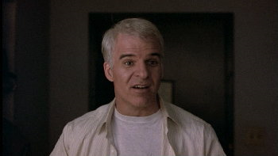
“Here’s a good idea: Have a point!”

Slide 7
To Make a Good Referral:
Know who you are referring your client to
Include pertinent information in the referral
Prepare both sides
Accompany the client if possible
Follow up with both sides

Slide 8
Marti Maltby
Program Director
House of Charity
m.maltby@houseofcharity.org
612-594-2005

