Slide 1
How to Make a Good Referral Marti Maltby Program Director

Slide 2
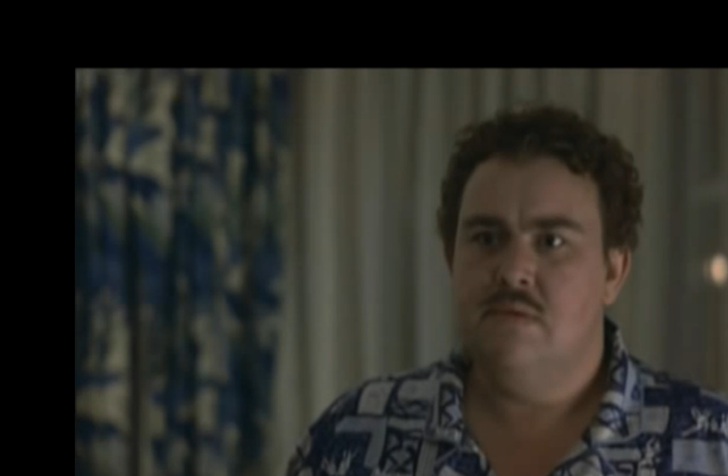

Slide 3
To Make a Good Referral:
Know why you are referring your client
Know who you are referring your client to
Discriminate in what information you include
Have a point
Prepare both sides
Accompany the client if possible
Follow up with both sides

Slide 4
Marti Maltby
Program Director
House of Charity
m.maltby@houseofcharity.org
612-594-2005

